Slide 1
Vergangenheit Notizen
“Past Tense Notes”

Slide 2
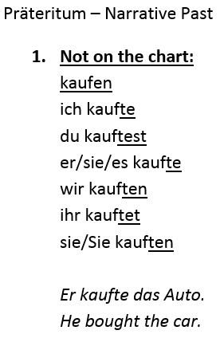
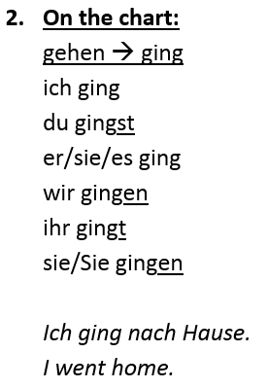
Präteritum Notizen
These verbs go in the 2nd position of a sentence (like present tense). They do not need helping verbs and they must be conjugated to fit the pronoun/subject.

Slide 3
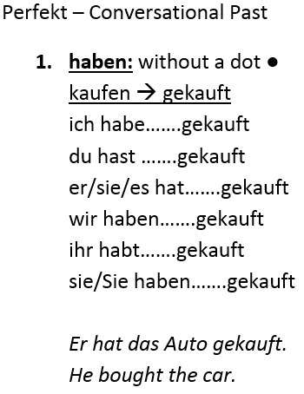
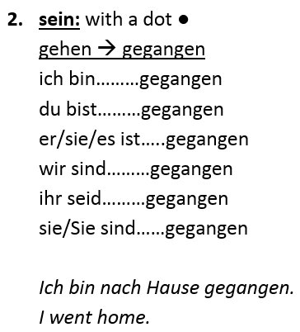
Perfekt Notizen
These verbs go at the end of a sentence and do need helping verbs (haben or sein) which go in the 2nd position and must be conjugated to fit the pronoun/subject.

Slide 4
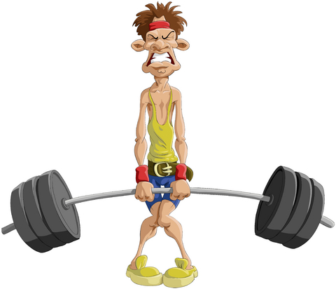
Regelmäßige/Schwache Verben - Not on the chart -
Regular/Weak Verbs: They do not have the “strength” to change their stems.
kaufen – to buy
Präsens: kaufen
Präteritum: kauften
Perfekt: gekauft
spielen – to play
Präsens: spielen
Präteritum: spielten
Perfekt: gespielt

Slide 5
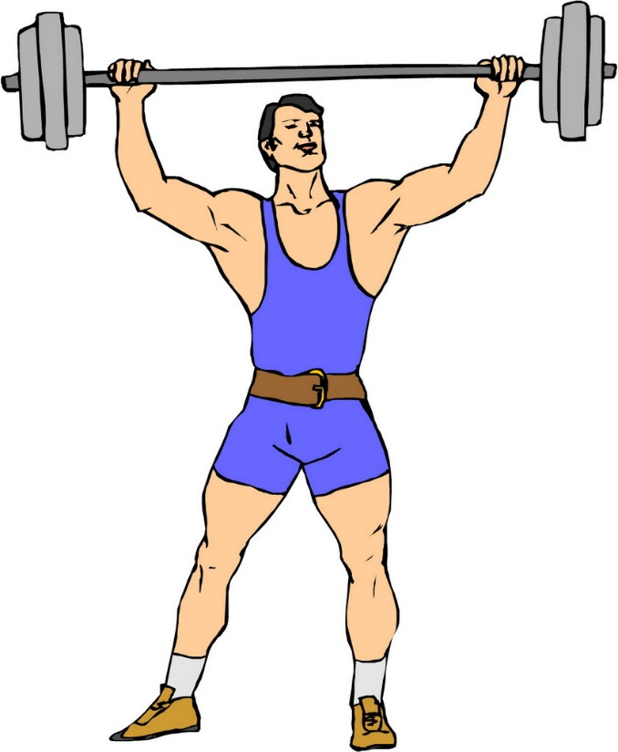
Unregelmäßige/Starke Verben - On the chart -
Irregular/Strong Verbs: They do have the “strength” to change their stems.
gehen – to go
Präsens: gehen
Präteritum: gingen
Perfekt: gegangen
singen – to sing
Präsens: singen
Präteritum: sangen
Perfekt: gesungen

